Slide 1






Climate change and its effect on crop yield in developing countries
A Case study of Nigeria, ghana, Kenya and south Africa.
Group 7 – The OUTLIERS

Slide 2
TEAM MEMBERS
Group 7 – THE OUTLIERS
Maryam Adesokan
Kenechukwu Iloegbunam
Ibukunoluwa Ogunnaike
Olajumoke Bakare
Mary Akinsande
Oreoluwa Daramola
Oluchukwu Okorie
Hamdiya Adams
Lilian Ugwu

Slide 3
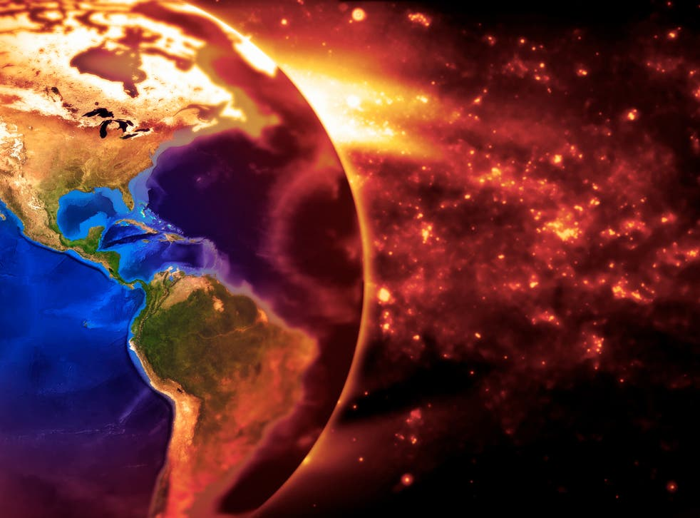
INtroduction
Global warming has become one of the major environmental issues in the world.
Case Study: The case study is Ghana, Kenya, Nigeria, and South Africa.
The goal of the study is to perform an exploratory analysis on how the variables of climate change affects crop yields.
Hypothesis: Does climate change have an effect on crop production in developing countries?

Slide 4

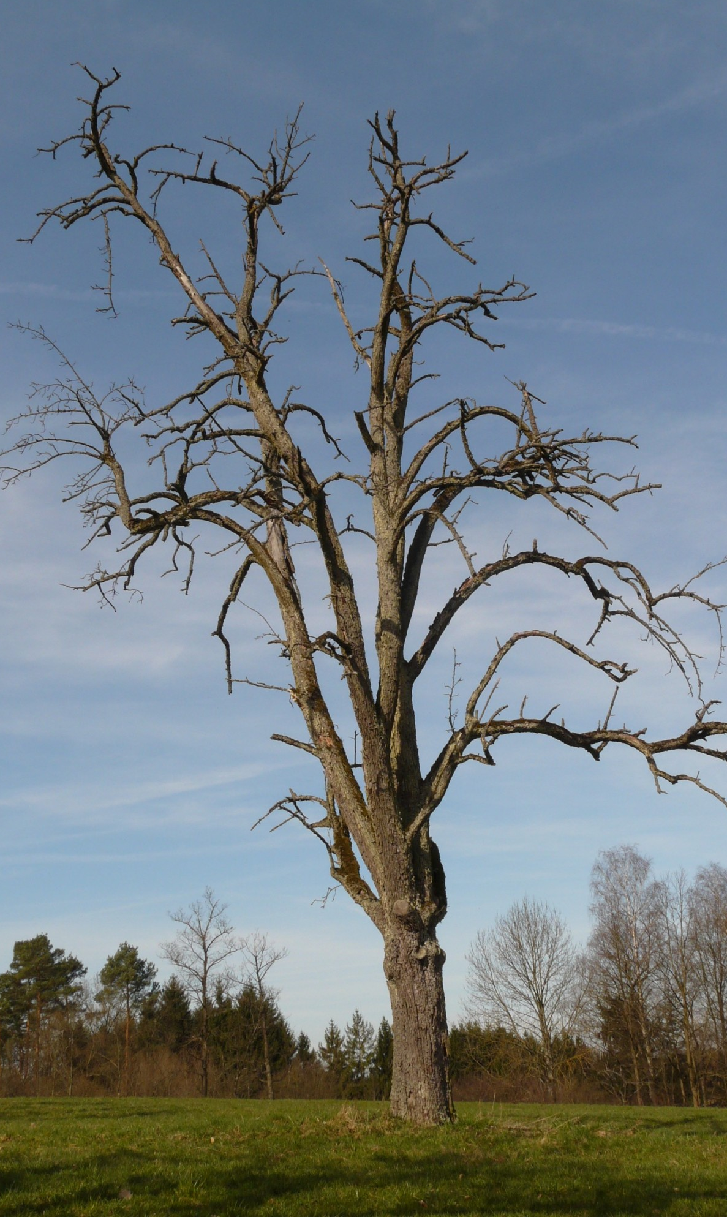
Sustainable development goals (SDGs)
The focus of our study is on:
SDG 12: Ensure sustainable consumption and production patterns
SDG 13: Take urgent action to combat climate change and its impacts
4

Slide 5
METHODOLOGY
Data collection: crop yield data was taken from https://ourworldindata.Org and weather indices data was taken from https://datahub.Com .
Data cleaning: data cleaning using excel to filter the columns. Python codes was used to drop columns that are not needed for the study.
Date visualization: Python libraries: Pandas, Numpy, Seaborn, Matplotlib was used.
5

Slide 6
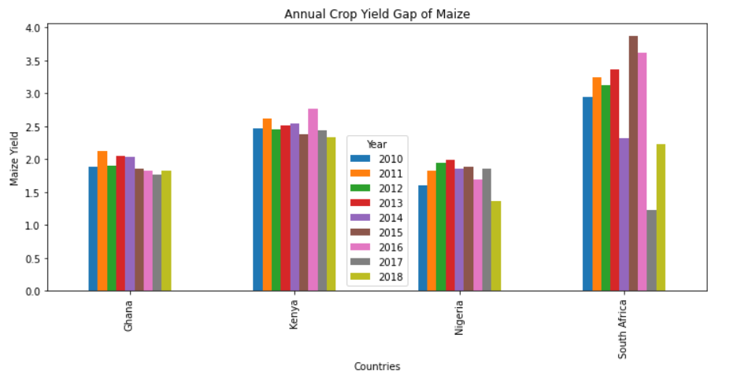
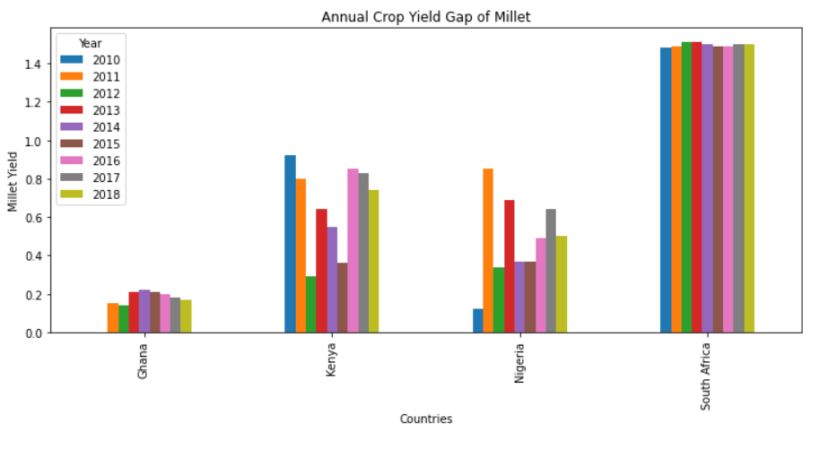
Annual crop YIELD GAP
The graphs indicates that Ghana and Nigeria have the lowest yield gap between the year 2010 to 2018 producing maize and millet and hence are the largest maize and millet producers.
Crop yield gap is the difference between yield potential and average farmers yield over a specified period of time.

Slide 7
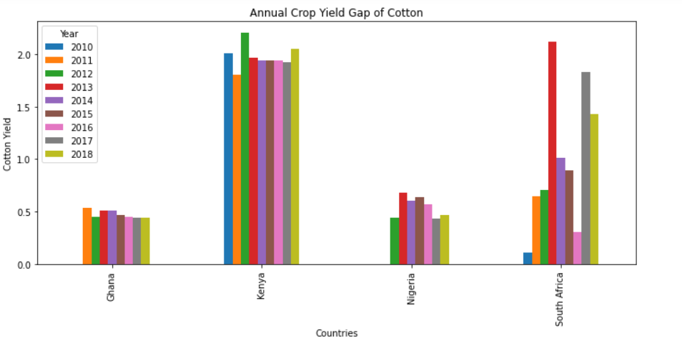
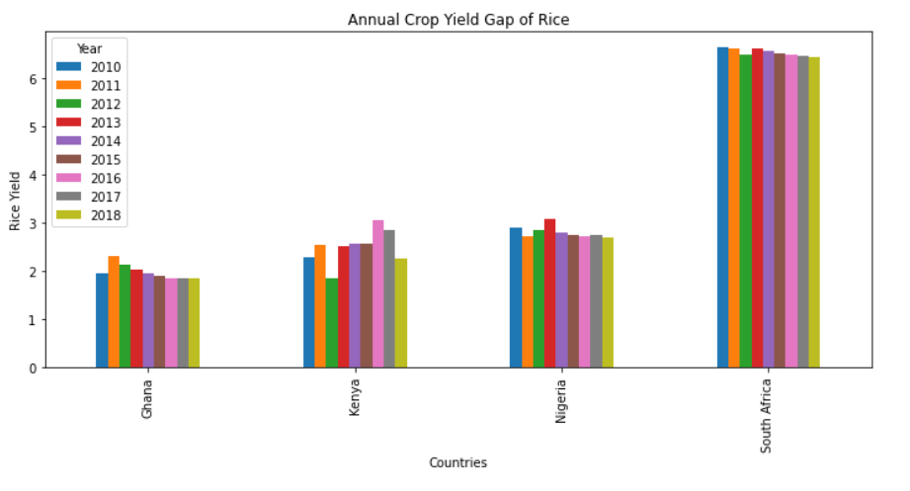
The graphs indicates that Ghana and Nigeria have the lowest yield gap between 2010 to 2018 producing cotton, while Ghana, Kenya and Nigeria maintain a close yield gap for rice, and also, close level of production.

Slide 8
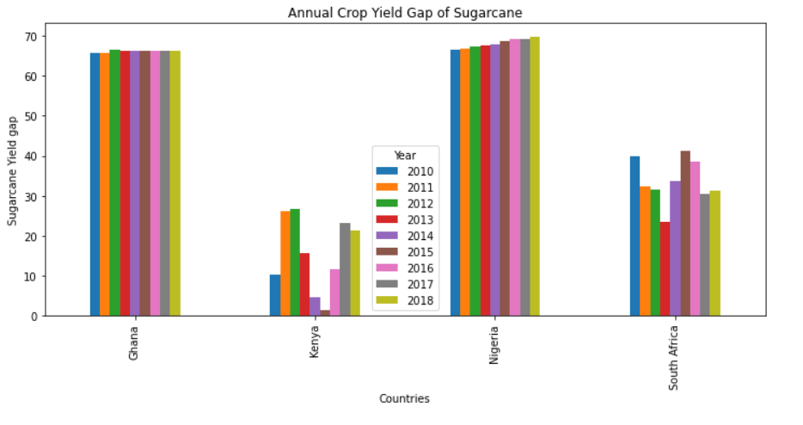
Nigeria and Ghana are the largest producing crop countries between the year 2010 to 2018 as shown in the previous slides
Sugarcane however proved to have last the test of time by gradually increasing in production in South Africa.
8

Slide 9
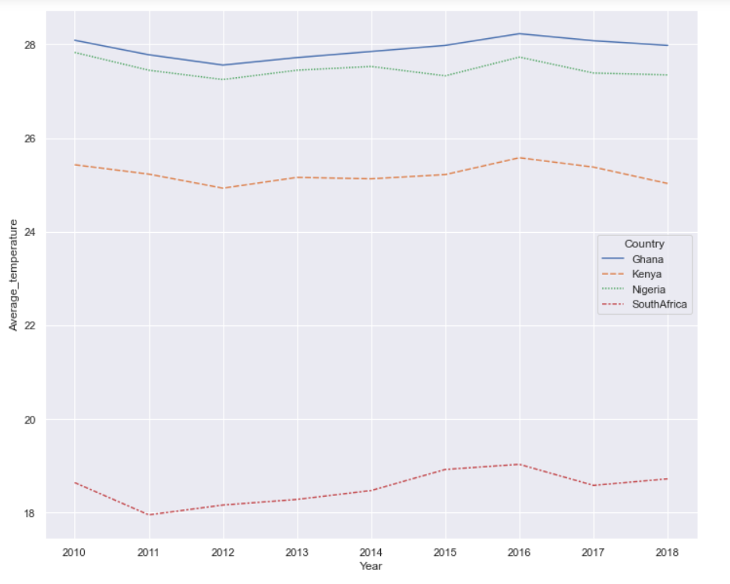
ANNUAL Average temperature
Ghana has shown to be the hottest country, followed by Nigeria at 27ºC – 28ºC minimum temperature between the year 2010 and 2018.
Kenya is the next hot state at 25ºC minimum temperature.
South Africa, the least crop producing country is seen to be the coolest country as its temperature is within 18ºC – 19ºC minimum temperature.

Slide 10
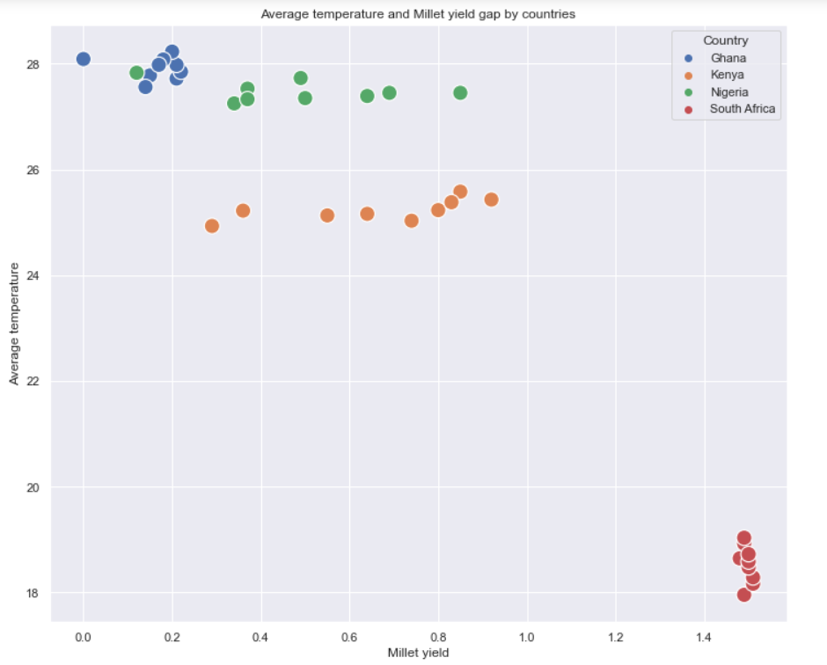
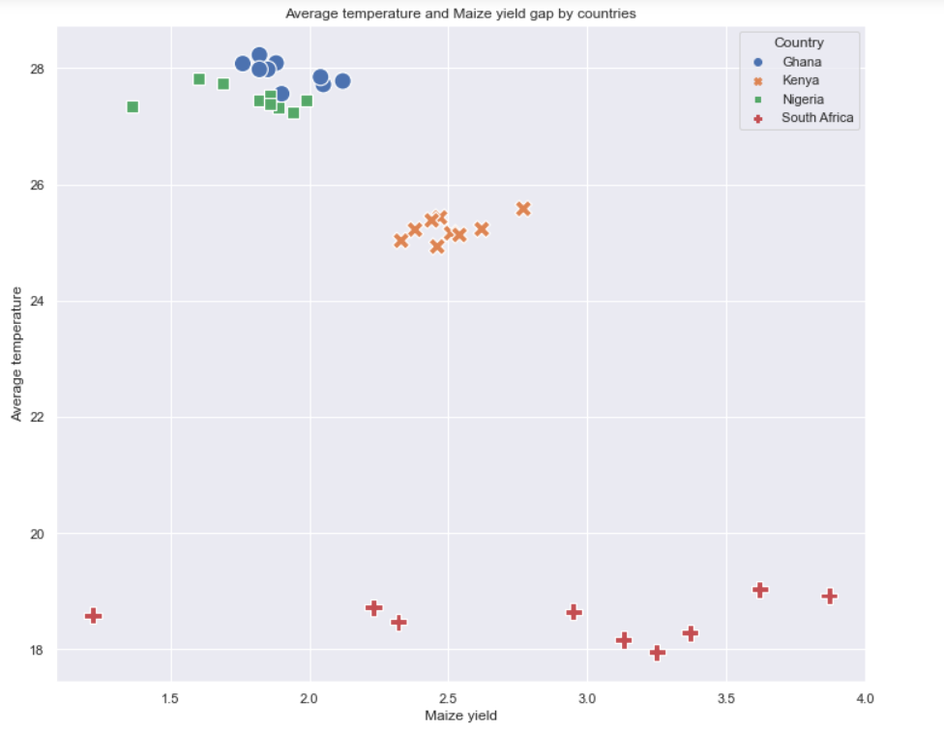
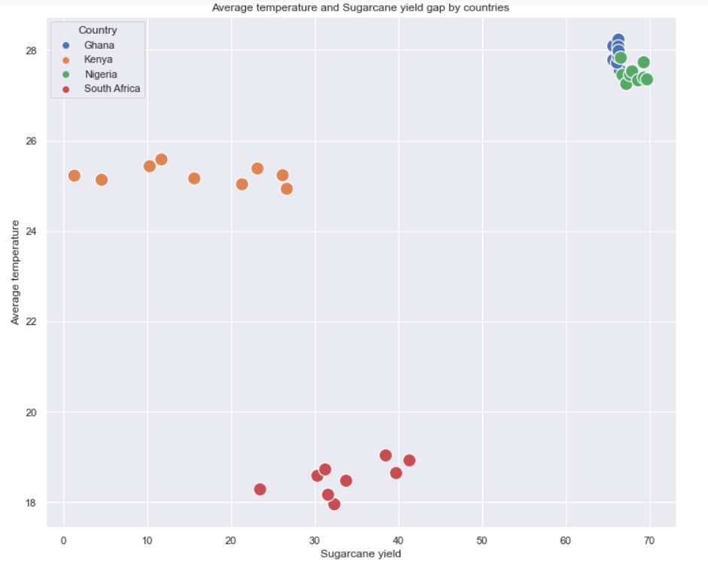
Annual AVERAGE temperature Vs crop yield
The graph shows that the higher the temperature, the higher the crop production and…
10

Slide 11
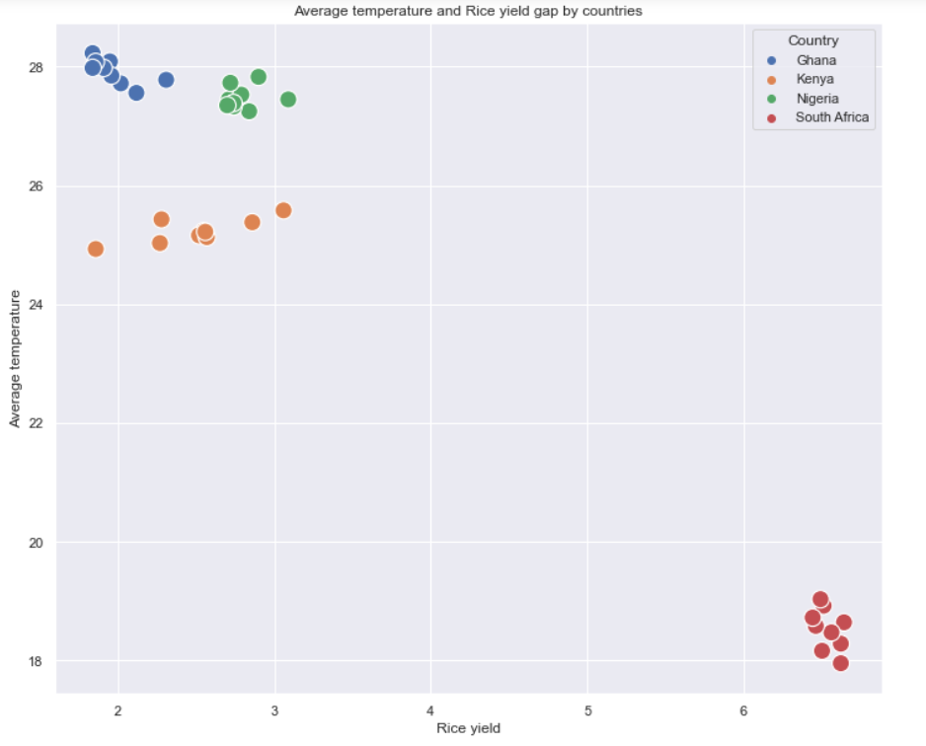
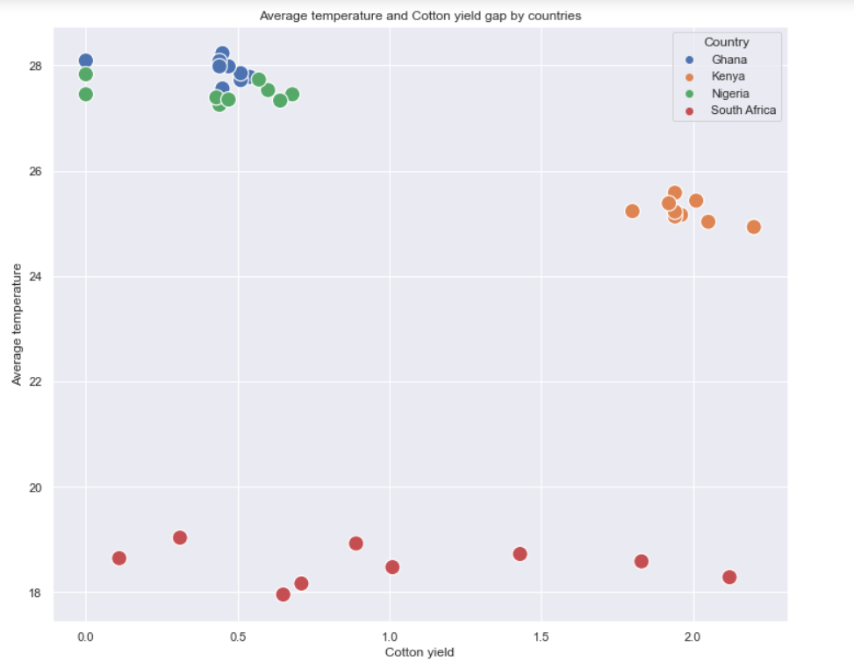
… the lower the temperature of the climate the lesser the crop production as seen in the case of Ghana and South Africa.
11

Slide 12
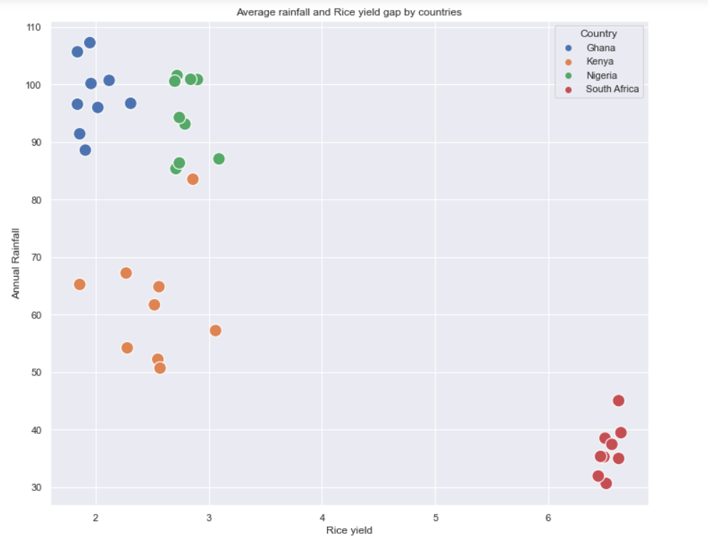
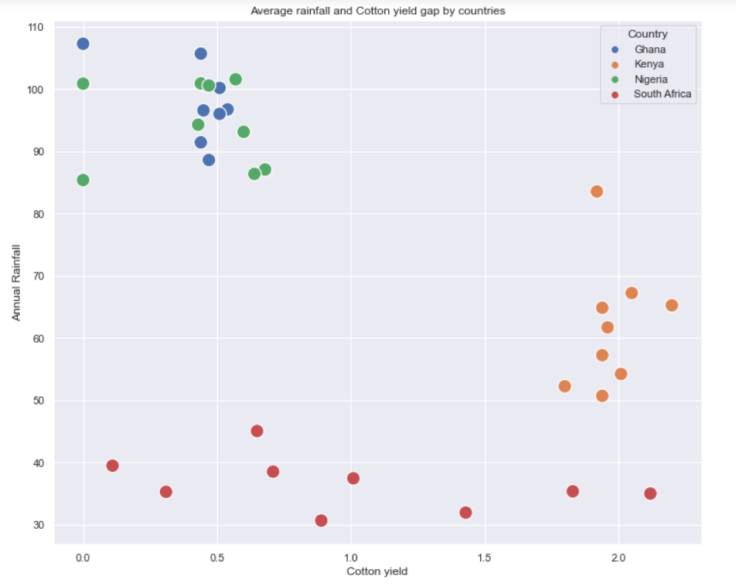
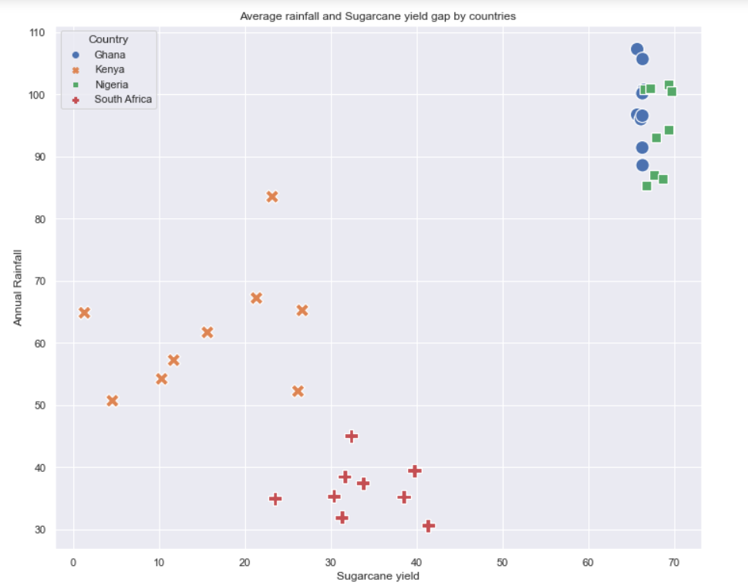
Annual Rainfall Vs and crop yield
12

Slide 13
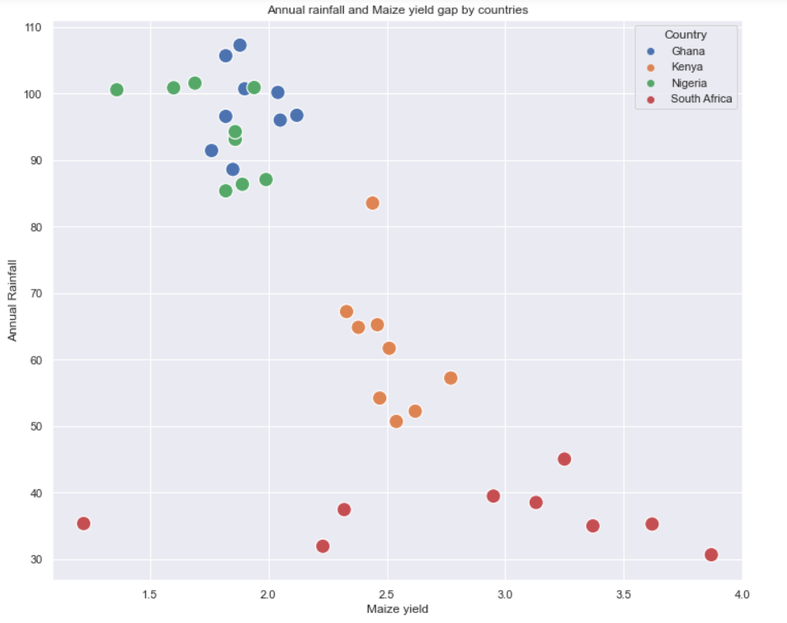
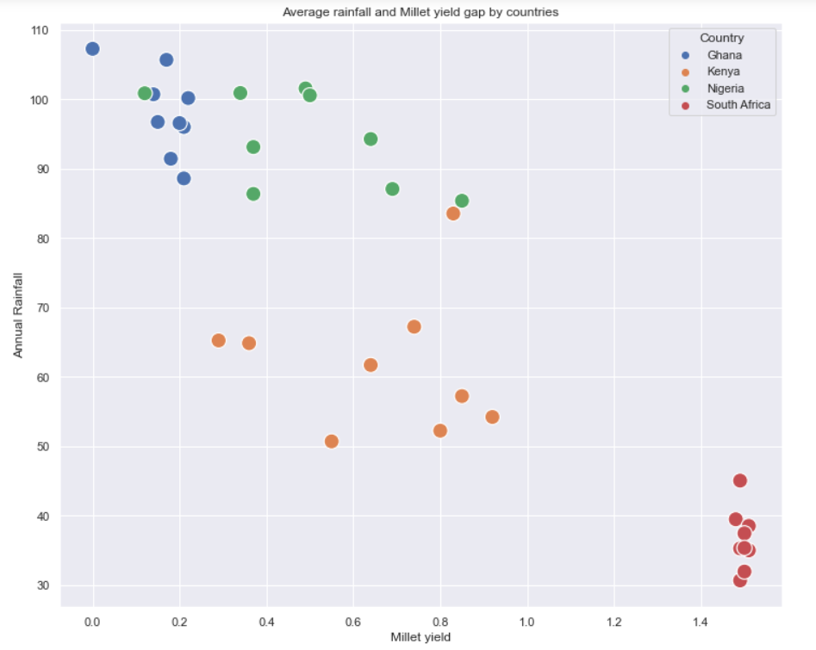
13

Slide 14
CONCLUSION
With visual analysis of crop production and climate change (rainfall and temperature) over a period of 8 years, it has been observed that climate indeed influence yield gap and is statistically significant to the crop production. Also, it is shown that there is an optimal temperature at which certain crops grow well, and it is observed here that at 27ºC temperature, at this temperature, countries had a lower yield gap and as such produced more crop for consumption.
Correlation between the total crop yield gap and average temperature is -0.927; total correlation between the crop yield gap and average rainfall is -0.924
Based on our findings, to a very large extent, climate change affect crop production and the yield gap annually. However, some crops like sugarcane are still favoured by climate change.
14

Slide 15
RECOMMENDATIONS
The following are the recommendations to aid higher crop production:
Use of alternative sources of fuel that are environmentally friendly. E.g. Biogas and geothermal energy.
Reduce dependency on rain fed agriculture and practice irrigation farming.
Adjustment of planting and harvest time.
Using Climate forecasting to reduce production risks.

Slide 16
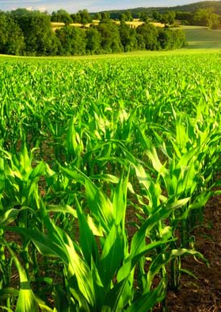
THANK YOU!

